Slide 1
Supercomputing Basics
John Mulligan, CRC, HRC
jcm10@rice.edu
Useful code for today at: https://github.com/JohnMulligan/ariel-demo

Slide 2
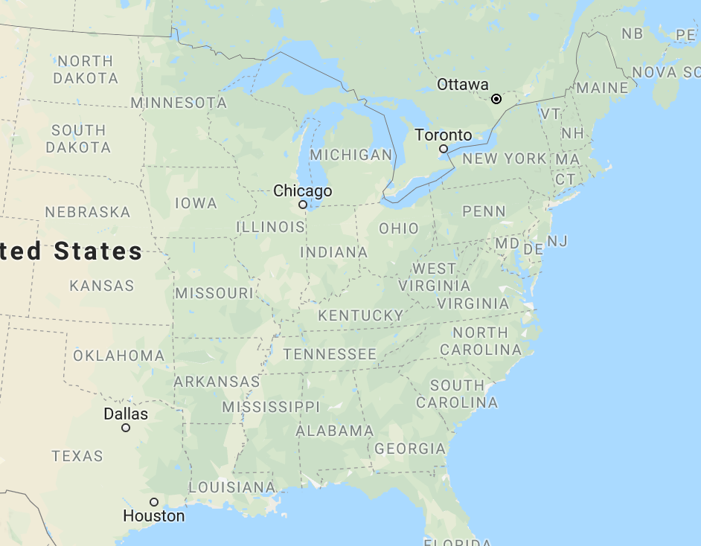


What is supercomputing? More cores not faster cores
Rice’s DAVinCI: 2400 processors in 192 Procs that can communicate with one another
Rice’s NOTS: 2784 processors in 158 Procs – no cross-Proc communication

Slide 3
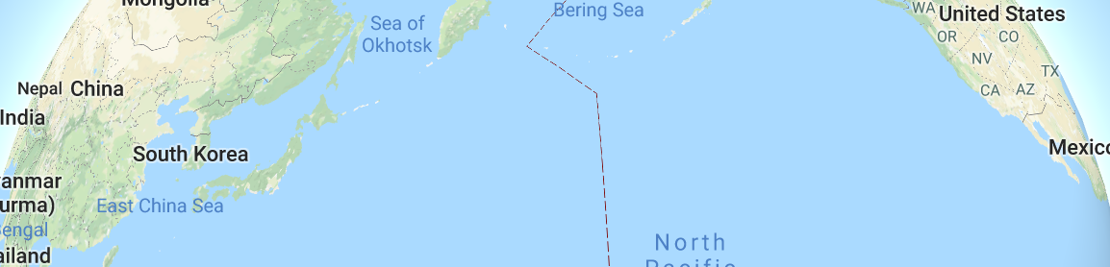

What is supercomputing? More cores not faster cores
Rice’s DAVinCI: 2400 processors in 192 Procs that can communicate with one another
Rice’s NOTS: 2784 processors in 158 Procs – no cross-Proc communication

Slide 4
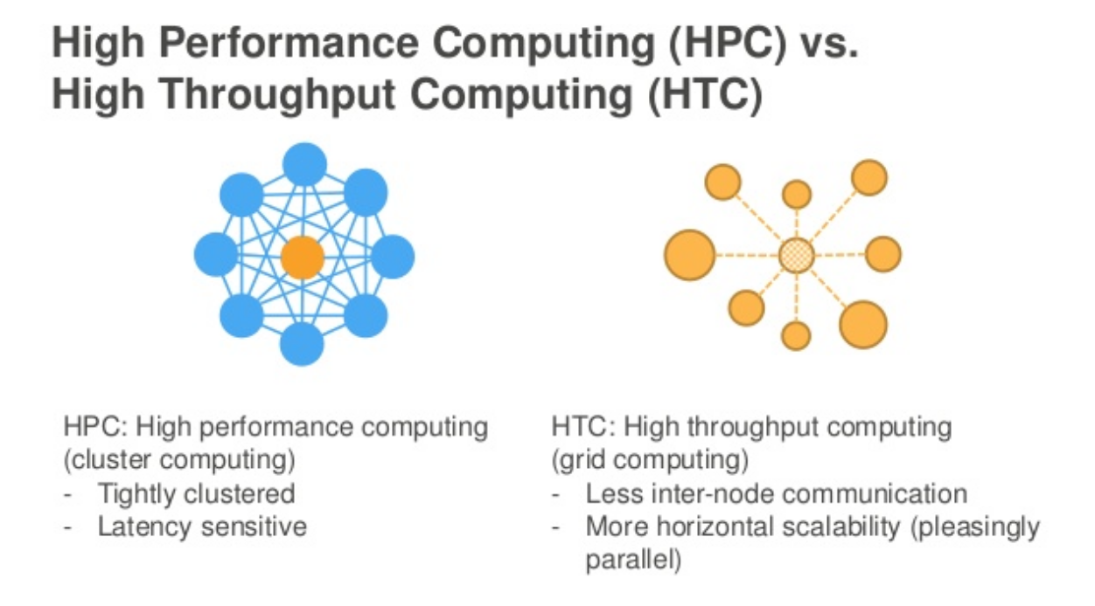
What is supercomputing? HTC vs. HPC (serial vs. parallel)
University of Madison Wisconsin’s CHTC: 30,000 cores – no cross-processor communication
Image via AWS re:Invent 2016: Building HPC Clusters as Code in the (Almost) Infinite Cloud (CMP318)

Slide 5
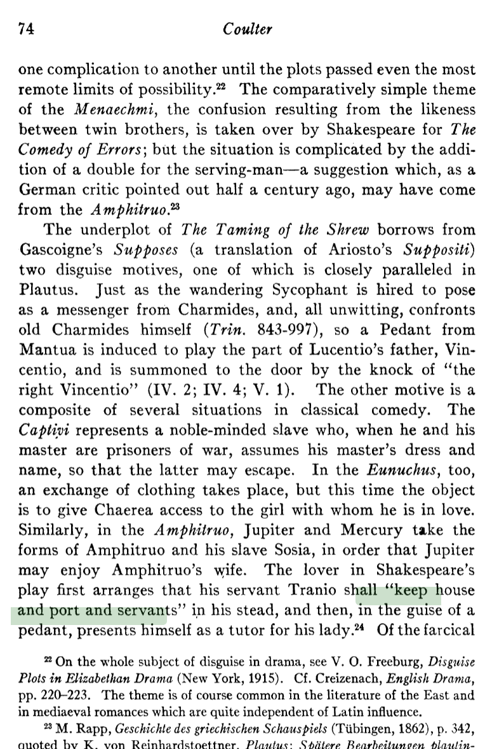
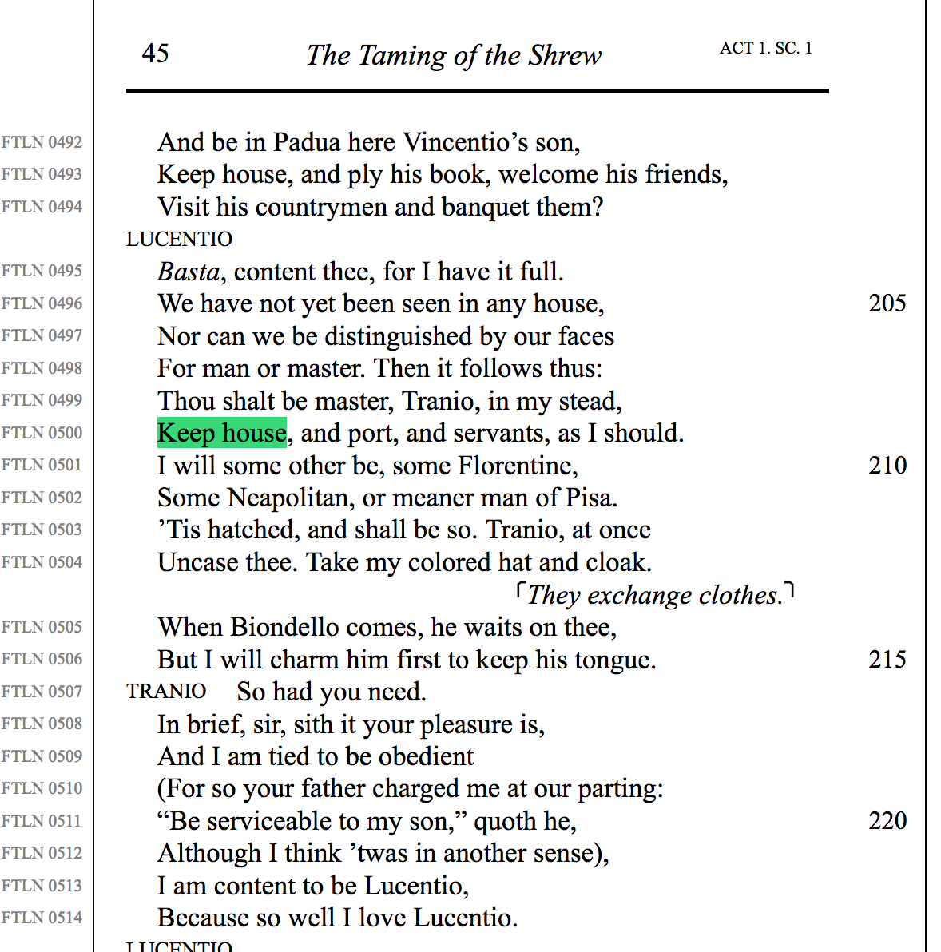
JSTOR citational dataset: articles to lines
71,639 article pdf’s
94,690 play lines
623,428
MATCHES

Slide 6
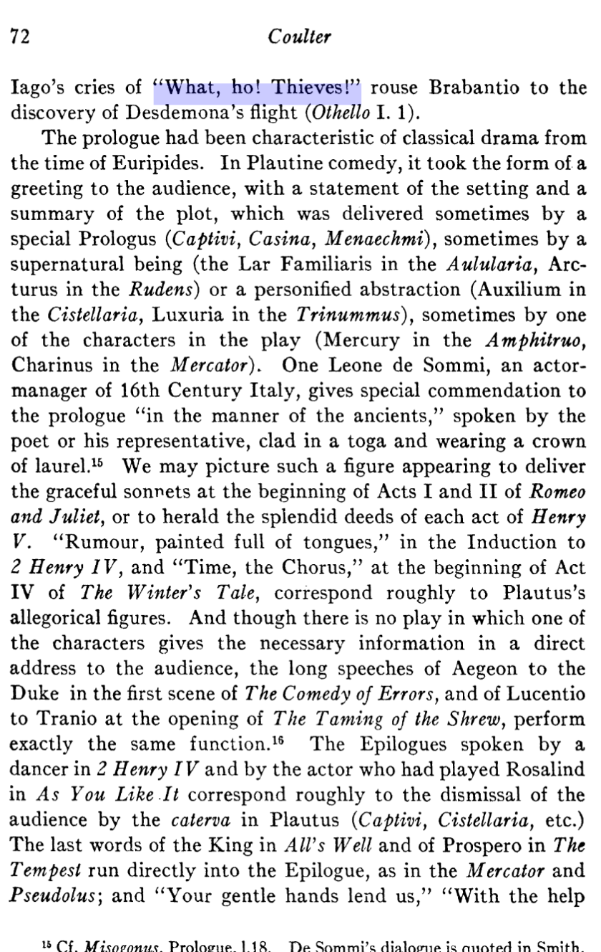
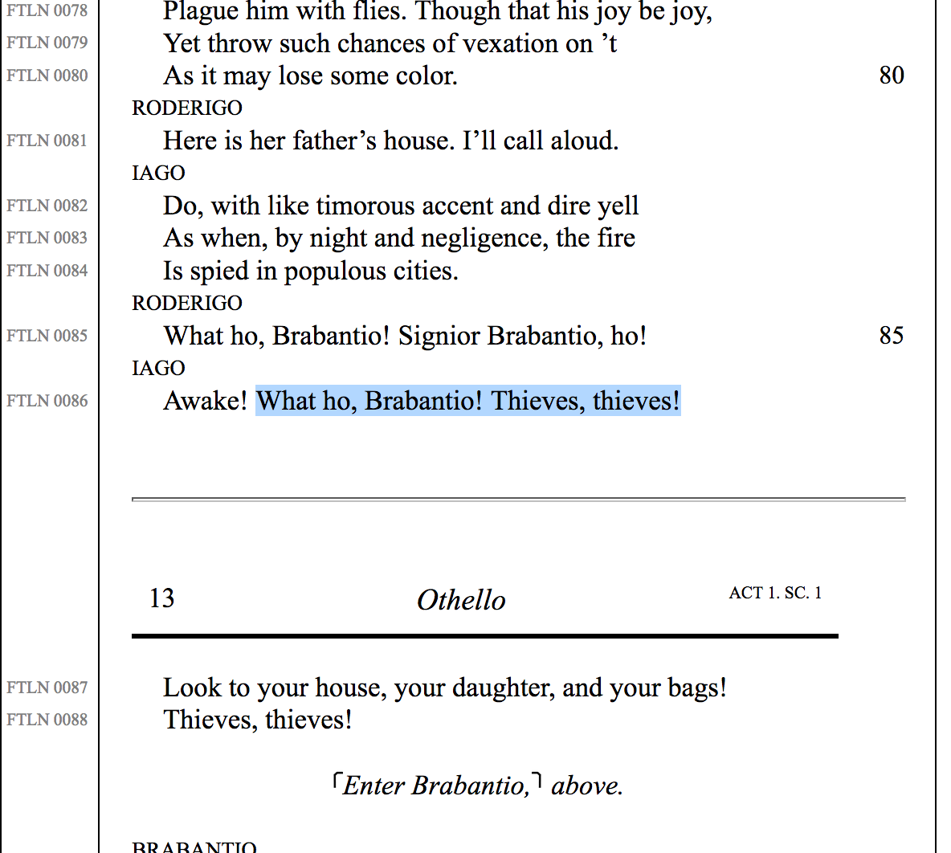
Implicit co-citational dataset: lines to lines (through articles)
29M
MATCHES

Slide 7
Process
For each document-to-line match: doc_{a}-line_{a}
Look up all the other lines cited by that document to make line-to-line-matches: [line_{a}/line_{b}, line_{a}/line_{c}, line_{a}/line_{d} …]
Write these to a central database that my interface can access.
(Do this 623,428 times)

Slide 8
Log into Davinci, and queue job

Slide 9
Shakespeare HTC structure (Condor)
Condor Network
68 hours real time
164 days compute time
produces
Submit Proc
Match DB 1
Match DB 2
Compiler Script
Compiled DB
……
Match DB 1058
Match Finder Proc 1
Match Finder Proc 2
Match Finder Proc 1058
……

Slide 10
Process
For each document-to-line match: doc_{a}-line_{a}
Look up all the other lines cited by that document to make line-to-line-matches: [line_{a}/line_{b}, line_{a}/line_{c}, line_{a}/line_{d} …]
Write these to a central database that my interface can access.
(Do this 623,428 times)

Slide 11
Shakespeare HPC/MPI Structure (Davinci)
Master/Checkpoint Proc
Write Proc 1
(“Home”)
Write Proc 2
(“Foreign”)
Match Finder Proc 1
Match Finder Proc 2
Match Finder Proc 3
Match Finder Proc N-3
……

Slide 12
Step 1. Master Assigns Batches of Work
Master/Checkpoint Proc
Write Proc 1
(“Home”)
Write Proc 2
(“Foreign”)
Match Finder Proc 1
Match Finder Proc 2
Match Finder Proc 3
Match Finder Proc N-3
……

Slide 13
Step 2. Workers Find Line-to-Line Matches
Master/Checkpoint Proc
Write Proc 1
(“Home”)
Write Proc 2
(“Foreign”)
Match Finder Proc 1
Match Finder Proc 2
Match Finder Proc 3
Match Finder Proc N-3
……

Slide 14
Step 3. Workers Send Results Back
Master/Checkpoint Proc
Write Proc 1
(“Home”)
Write Proc 2
(“Foreign”)
Match Finder Proc 1
Match Finder Proc 2
Match Finder Proc 3
Match Finder Proc N-3
……

Slide 15
Step 4. Recorders Write Results to Databases
Master/Checkpoint Proc
Write Proc 1
(“Home”)
Write Proc 2
(“Foreign”)
Match Finder Proc 1
Match Finder Proc 2
Match Finder Proc 3
Match Finder Proc N-3
……

Slide 16
Step 5. Master Records Work as Done, Workers Receive New Batches of Work
Master/Checkpoint Proc
Write Proc 1
(“Home”)
Write Proc 2
(“Foreign”)
Match Finder Proc 1
Match Finder Proc 2
Match Finder Proc 3
Match Finder Proc N-3
……

Slide 17
Limits
External:
8-hour hard limit on jobs (fix: checkpointing for graceful exits and restarts, using Signal function)
Memory allocated for each process (fix: monitor and allocate properly)
Internal:
Bottlenecking, as workers line up to send results to writers (fix: load balancing)

Slide 18
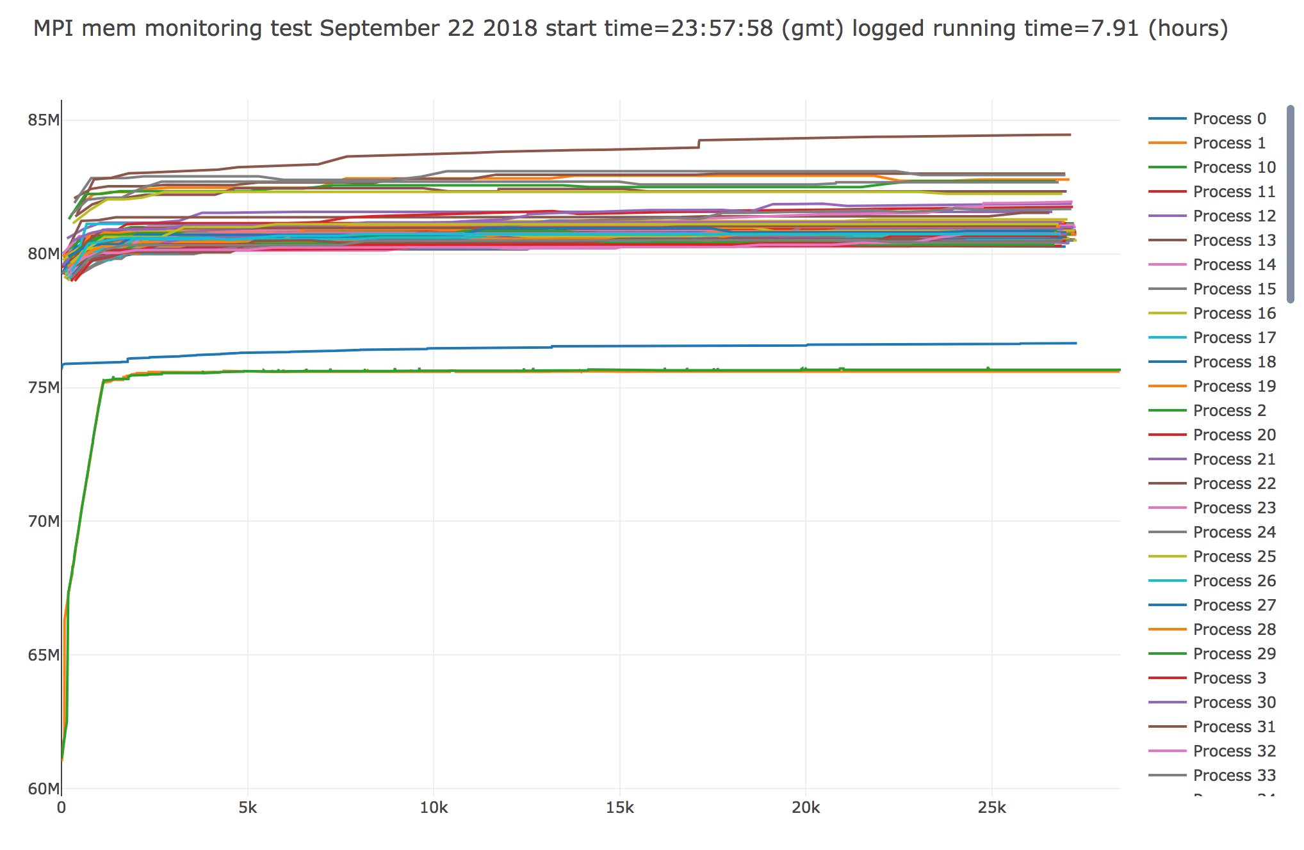
Memory usage monitoring

Slide 19
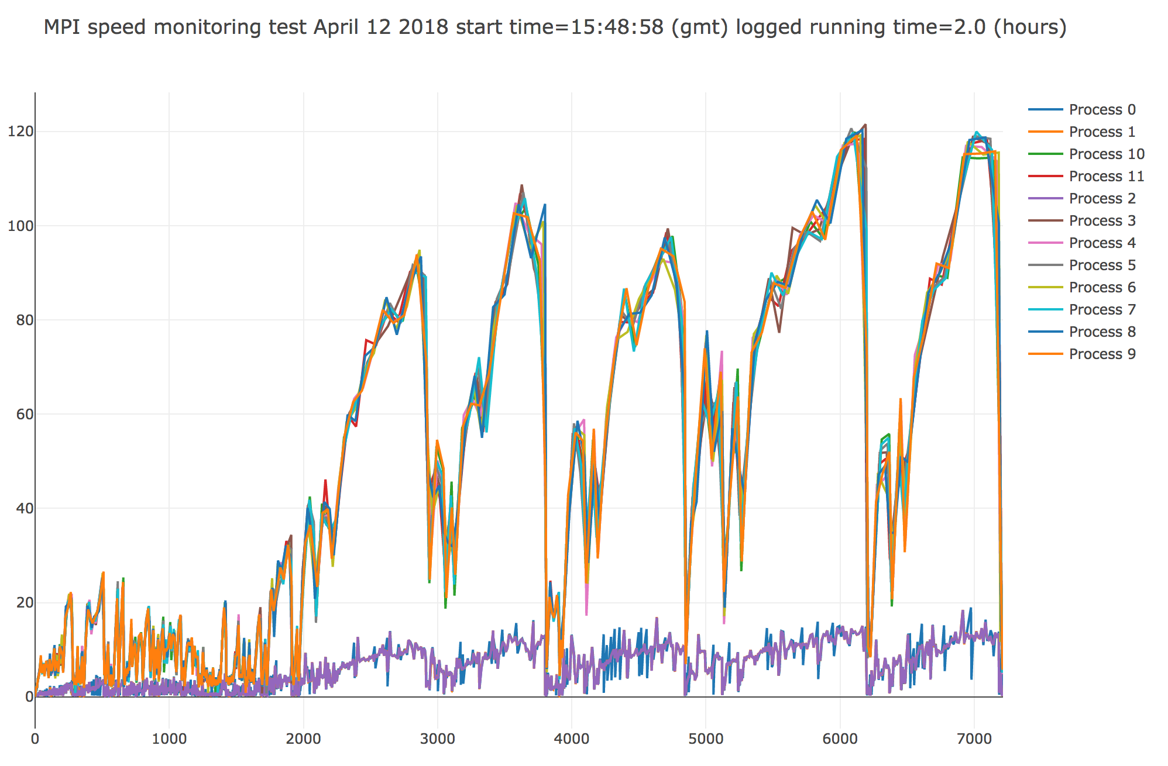
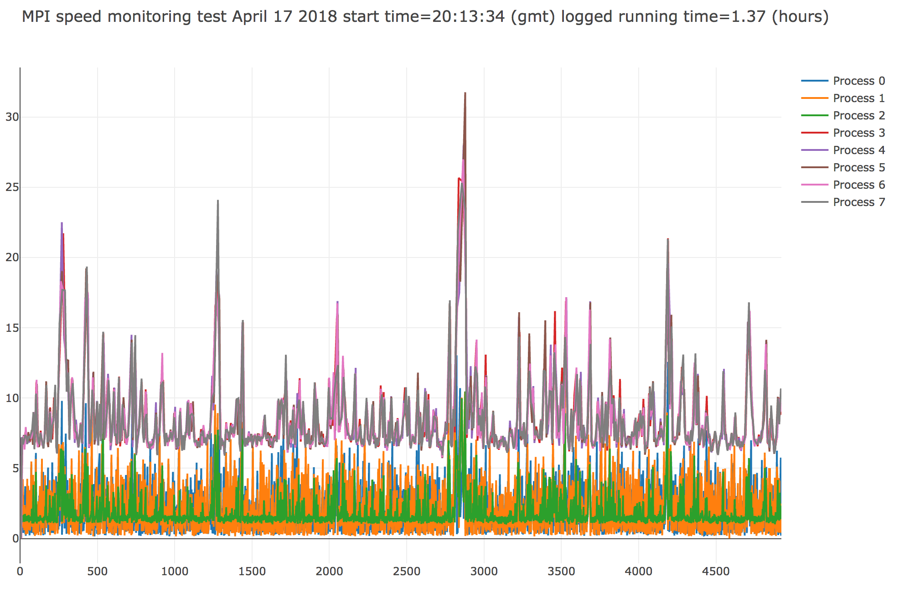
Loop time monitoring and bottlenecking

Slide 20
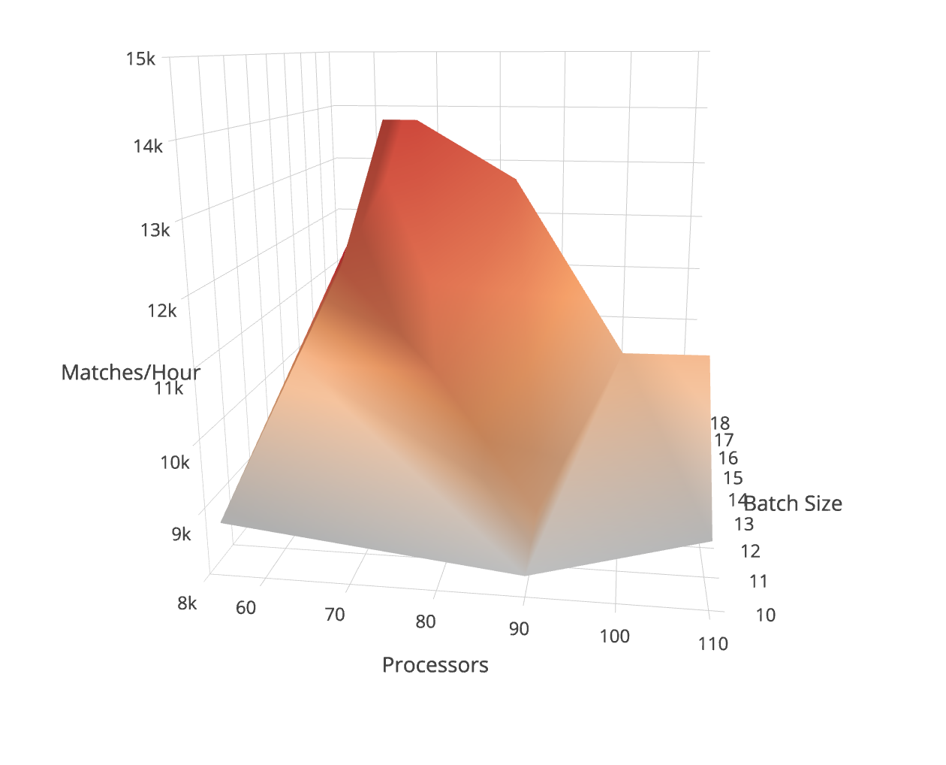
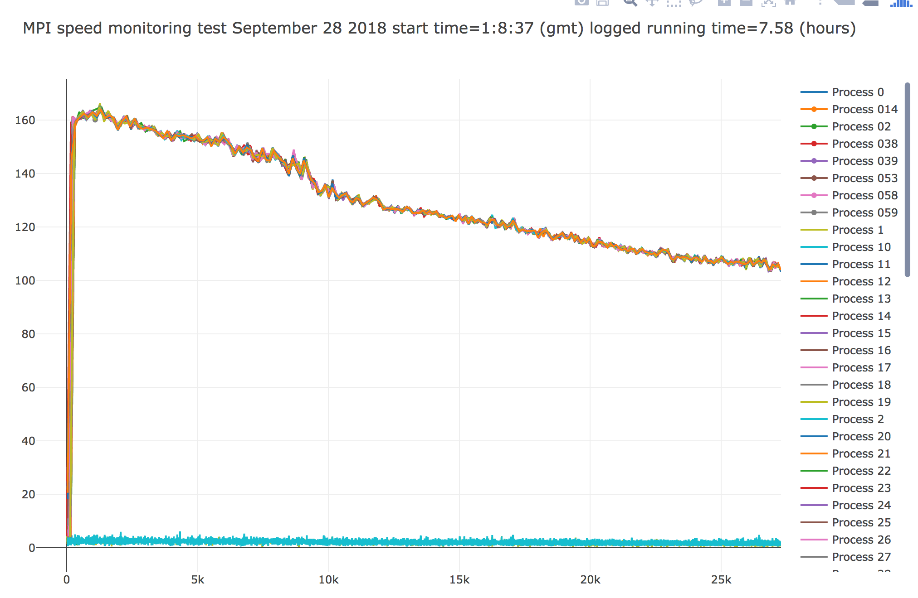
Optimization on parameters
https://plot.ly/~johncmulligan/9/#/

